Slide 1

Spotify EDA
Jaden Wilkins
Jonathan Penaloza Rumie
10-26-2022

Slide 2
Introduction
Our dataset included all the songs that have been on the Top 200 Weekly (Global) charts of Spotify in 2020 & 2021
With 1,556 entries, there was a lot of data to investigate
We mainly decided to focus on how song duration affects popularity
This would help us find what makes songs popular, or at least what hit songs have in common

Slide 3
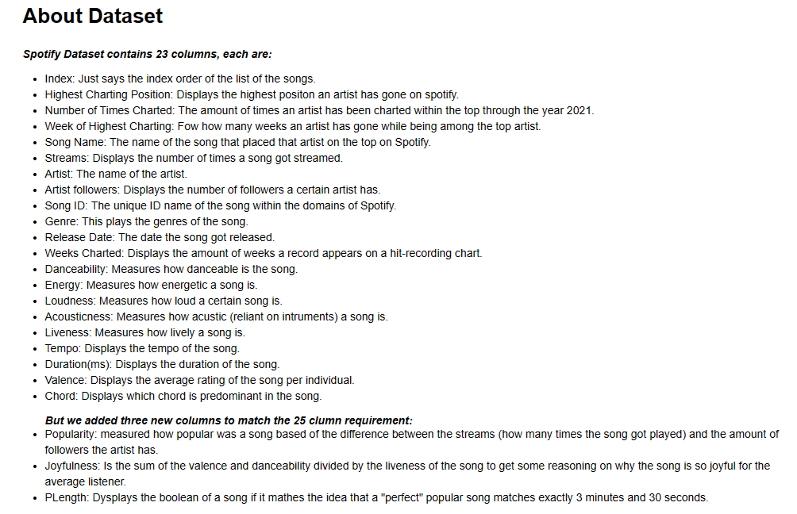
About Dataset
We have a total of 25 columns.
4 integers
8 objects
11 floats
We experience some issues with some of the columns that were just blank and the rows that had empty values were deleted.

Slide 4
Data Source
We found our dataset on Kaggle, and took interest in it due to Jonathan’s music background
Along with song titles, our dataset had columns such as song duration, artist name, artist followers, and more
Originally, we had only 23 columns, so we added a few of our own
Popularity: “Streams” - “Artist Followers. This was done to track new artists’ rise to fame
PLength: Added songs to column if the duration was less than 3.5 minutes
Joyfulness: (“Valence” + “Danceability”) / “Liveness”

Slide 5

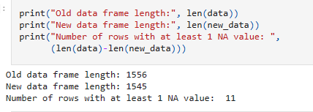
Data Cleaning and Preprocessing
As mentioned, originally, we had only 23 columns, so we added some
Also, some of the continuous variables were showing up as objects and not integers, so that also required manual adjusting on the csv file
11 of the 1556 songs had null values, so we made a new data frame that dropped the non-applicable values

Slide 6
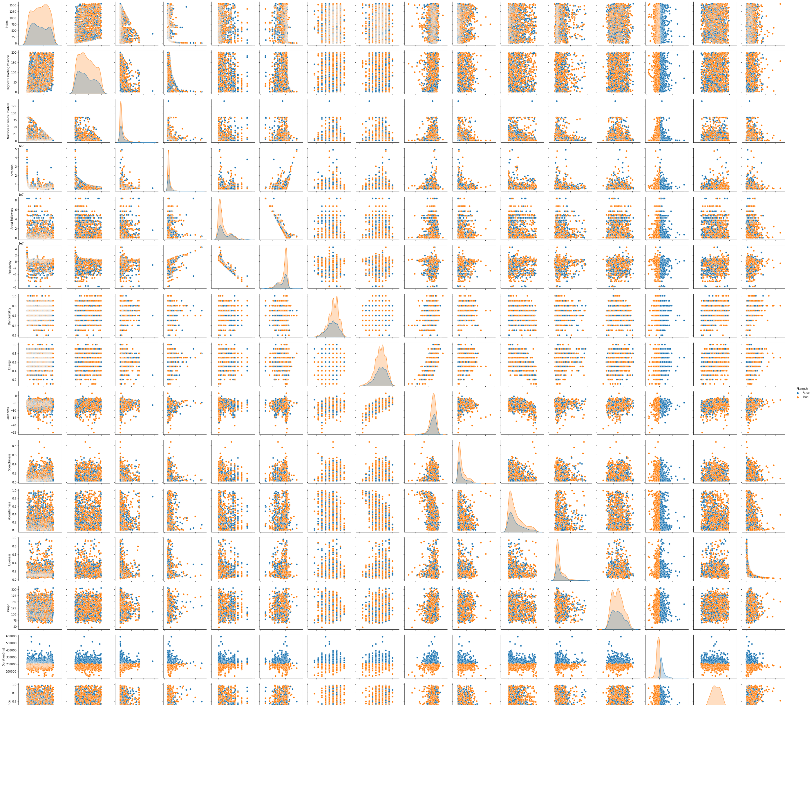
Data Exploration
We used Seaborn and matplotlib the most to come to our findings
First, we used Seaborn for the pair plot (right)
Next, we took a deeper dive into the correlation between columns

Slide 7
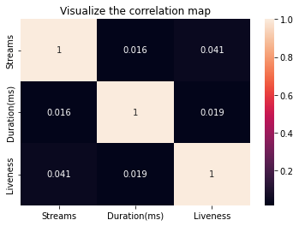
Data Exploration
Next, we found the correlations between “Streams”, “Duration”, and “Liveness”
“Liveness” describes how long it takes for a sound to reverberate in a song, simulating a live performance
Then, we made a heatmap to visualize our findings (right)

Slide 8
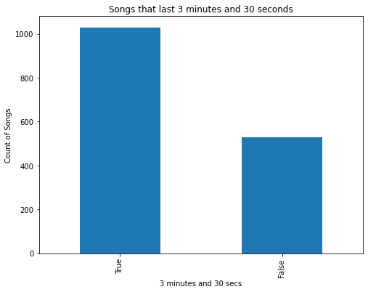
Data Exploration
The next two plots we crafted compared duration to songs and artists, respectively
In the first bar chart, we got a count of how many songs are less than or greater than 3.5 minutes (right)
It is worth noting that most of the songs on the charts were of shorter length than what we have seen historically

Slide 9
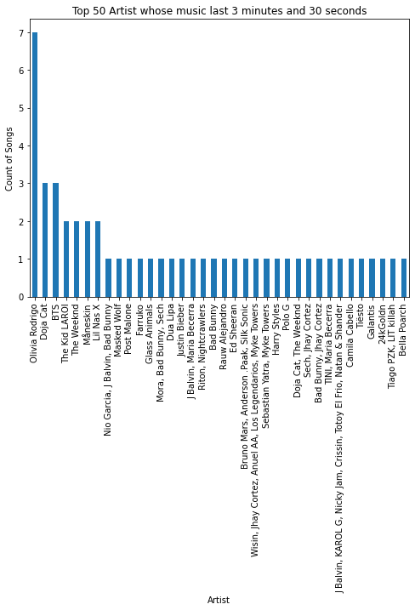
Data Exploration
In the second bar chart, we examined the artists who made up the top fifty spots on the charts
We wanted to see how many of their songs in the dataset were longer than 3.5 minutes
For context 3.5 minutes is considered the average song length as of 2019

Slide 10
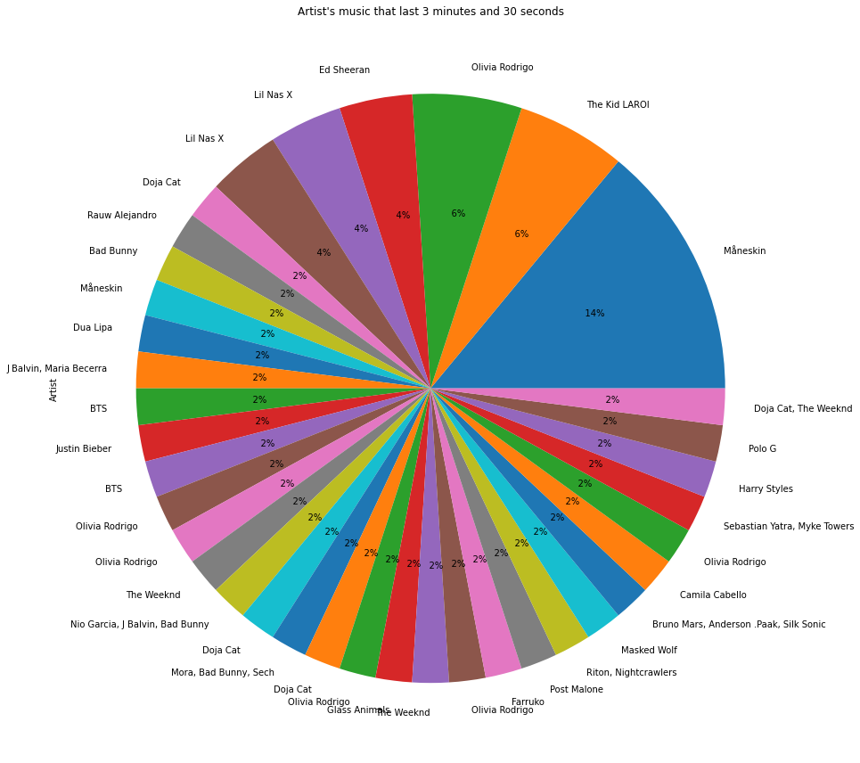
Data Exploration
We graphed the prior bar chart in pie form as well (right)
The one difference is instead of counting the number of songs over 3.5 minutes, we calculated the percentage of each artist’s songs over 3.5 minutes

Slide 11
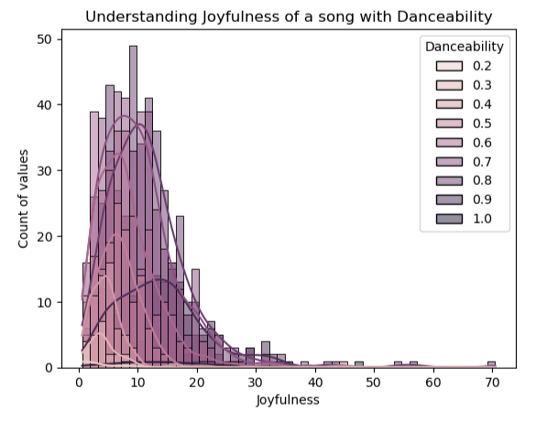
Data Exploration
Our histogram does not focus as much on popularity
It tries to understand how joyful music is based off its danceability (right)
Of note: “Joyfulness” the x-axis and “Danceability” the y-axis are both columns in the dataset

Slide 12
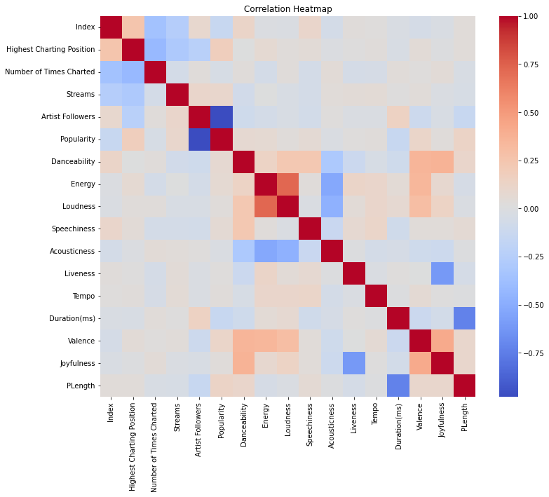
Data Exploration
Finally, we made a correlation heatmap to find any more relationships we could have missed (right)

Slide 13
Analysis
Our hypothesis was that shorter songs are becoming more popular as the population’s attention span slowly declines
Our hypothesis was correct, as a sweeping majority of the songs on the charts are under 3.5 minutes, or average length
With this data, we could let an aspiring artist know what needs to be done to make the Top 200 charts

Slide 14
Discussion/Conclusion
Songs with a shorter duration will have an easier time charting
Danceable and joyful songs will have a bigger outreach
We were able to find a strong relationship between duration and popularity

Slide 15
Q&A

